Slide 1
La Crisis Post-Penitenciaria
2022 GLOBAL FORUM LATIN AMERICA AND THE CARIBBEAN
Marcelo Bergman
Untref-Argentina
New York Septiembre 21-23,2022

Slide 2
Crecimiento de la población carcelaria
 | Population 1992 | Rate 1992 | Population 2017 | Rate 2017 | Change pop. 1992-2017 | Change rate 1992-2017
Argentina (b) | 21,016 | 62 | 81975 | 186 | 390% | 200,0%
Belice | 617 | 316 | 1297 | 356 | 110% | 12,7%
Bolivia(a) (c) | 5412 | 69 | 17946 | 156 | 395% | 126,1%
Brazil (c ) | 173,104 | 107 | 682901 | 326 | 394% | 204,7%
Chile (c ) | 20,989 | 154 | 41689 | 228 | 199% | 48,1%
Colombia(c) | 27,316 | 78 | 117026 | 237 | 428% | 203,8%
Costa Rica | 3,443 | 107 | 19226 | 374 | 558% | 249,5%
Ecuador(c) | 7,998 | 75 | 37497 | 222 | 469% | 196,0%
El Salvador (b) | 5,348 | 97 | 36824 | 579 | 688% | 496,9%
Guatemala | 5,592 | 59 | 23358 | 136 | 418% | 130,5%
Guyana | 1,404 | 194 | 2004 | 259 | 143% | 33,5%
Honduras* | 5,717 | 109 | 18950 | 216 | 331% | 98,2%
Mexico (b) | 85,712 | 98 | 236886 | 186 | 276% | 89,8%
Nicaragua | 3,375 | 85 | 17196 | 276 | 509% | 224,7%
Panamá | 4,428 | 174 | 16183 | 390 | 365% | 124,1%
Paraguay (a) | 2768 | 57 | 13607 | 199 | 392% | 249,1%
Peru (c) | 15,718 | 69 | 86800 | 269 | 552% | 289,9%
Uruguay | 3,157 | 100 | 11078 | 321 | 351% | 221,0%
Venezuela* | 23,2 | 108 | 57096 | 178 | 246% | 64,8%
Total | 408,134 |  | 1519539 |  | 372%
Some Non LATAM
Spain (d) | 45,198 | 115 | 59,694 | 128 | 32.0% | 11.3%
France (d) | 51,623 | 89 | 71,190 | 110 | 37.9% | 23.5
USA (d) | 1,585,586 | 592 | 2,121,600 | 655 | 33.8 | 10.6
S. Korea (d) | 60,166 | 135 | 56,495 | 112 | -6.1% | -17.0%
China (96-14) | 1,417,000 | 114 | 1,657,812 | 119 | 18.9% | 4.3%
Russia (d) | 920,685 | 622 | 646,085 | 448 | -29.7% | -27.9%
Poland (d) | 61,136 | 160 | 71,528 | 188 | 16.9% | 17.5%

Slide 3
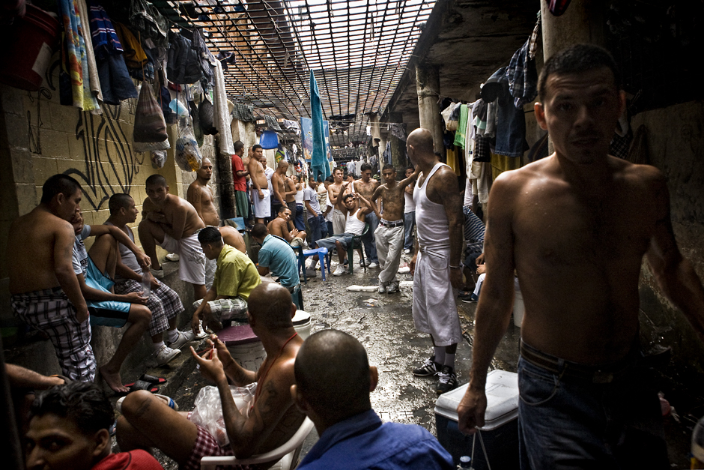
The Aftermath of Mass Incarceration:
Two million people behind bars in Latin America.
Approximately, every year 400,000 re-enter society. An estimated 70% will recidivate during the first six months.
Incarceration growth is flow driven (lots of admissions with short sentences) An estimated 10 million that have passed through our penitentiary systems in the last two decades.
Our prisons do not rehabilitate, they do not sufficiently deter delinquents, they do not incapacitate.
The politics of mass incarceration did not solved the crime problem, it probably made things worse.

Slide 4
The Problem of Recidivism
Prisons are criminogenic because inmates improve their criminal skills, they forge allegiance with criminal networks, they develop criminal governance from within prisons.
Transitions from prison to freedom is extremely difficult (employment, addiction, family, debts, etc).
Falling back to crime becomes attractive.
Persistent high rates of crime result in part from the millions of ex-convicts who recidivate upon release.

Slide 5
Interventions
Recalibrate punitive policies (prisons are for violent criminals).
Invest heavily in alternative to prisons and in monitoring for potentially dangerous inmates.
Pre-release programs with intensive supervision (the first six months are critical).
Extensive support for civil society organization working on re-entry.
Monetary incentives for staying out of crime…
Create a well funded special unit for post release inmates (it is cheaper than prisons).

Slide 6
mbergman@untref.edu.ar
http://marcelobergman.com http://www.celiv.untref.edu.ar

